Slide 1

Project Title- Keylogger using Python
By- Abhay Kumar Pandey
IBM SkillsBuild & AICTE Internship, by Edunet Foundation
Date: 22 July 2023
Email id: abhayp1334@gmail.com
Student ID:STU6457772b99a231683453739

Slide 2
Project Overview
The Python Keylogger is a software project aimed at monitoring and logging keystrokes on a computer system. It records all user keyboard inputs covertly, storing the data locally for later analysis. This project serves various purposes, including studying user behavior, enhancing security, and supporting authorized monitoring for specific applications.
The Python Keylogger project demonstrates a functional and stealthy solution for monitoring keystrokes on a computer system. While its implementation is simple and effective, the project must be handled with caution due to ethical and privacy concerns. By incorporating suggested improvements and emphasizing responsible usage, the Python Keylogger could be a valuable tool for educational purposes and authorized monitoring scenarios.

Slide 3
Problem Statement
The objective of this project is to develop a Python-based Keylogger application that can covertly monitor and log all keyboard inputs on a computer system. The keylogger should operate stealthily in the background, recording keystrokes without the user's knowledge or interference. The logged data should be securely stored for later analysis. The project aims to serve legitimate purposes, such as studying user behavior, enhancing security, and supporting authorized monitoring, while also addressing ethical concerns and privacy considerations to ensure responsible usage.

Slide 4
Methodology
Setup: Prepare the Python development environment for compatibility with the target system's OS.
Research: Gather insights on keylogging techniques, security, and ethics.
Keystroke Capture: Implement code to covertly capture and log keyboard inputs using Python libraries.
Ethical Guidelines: Incorporate disclaimers and consent requirements.
Testing: Thoroughly test and debug the keylogger

Slide 5
Project Impact
The impact of the Python Keylogger project can be significant in various domains, offering both positive contributions and potential risks:
Security Enhancement: The keylogger can be used by individuals and organizations to monitor and detect unauthorized access attempts, potentially preventing security breaches and data theft.
User Behavior Analysis: Researchers and developers can utilize the keylogger for studying user behavior patterns, analyzing typing habits, and improving user interface design.
Employee Monitoring: In certain organizations, authorized employee monitoring can be essential for maintaining productivity and ensuring compliance with company policies
Educational Tool: As an educational tool, the project can help individuals learn about keylogging techniques, Python programming, and cybersecurity best practices.
Ethical Concerns: Responsible deployment of the keylogger with proper consent and authorization can help address ethical concerns and ensure users' privacy rights are respected.

Slide 6
Applications
Parental Control: Parents can use the keylogger to monitor their children's online activities and protect them from potential threats or inappropriate content.
Employee Monitoring: Companies can deploy the keylogger to monitor employees' computer activities within the workplace to ensure productivity and adherence to company policies.
User Experience Research: UX designers and researchers can employ the keylogger to gather data on how users interact with software applications and improve the overall user experience.
Security Auditing: The keylogger can be employed in security audits to identify potential vulnerabilities and unauthorized access attempts.
Law Enforcement: In authorized scenarios, law enforcement agencies can use the keylogger to gather evidence for criminal investigations.

Slide 7
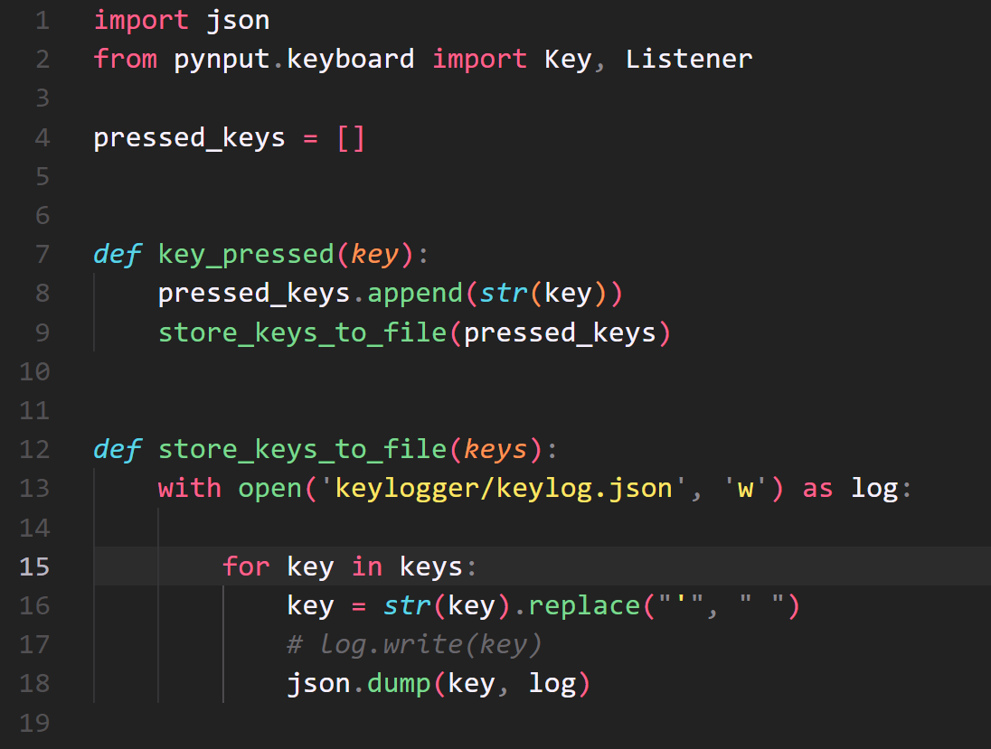
Code:

Slide 8
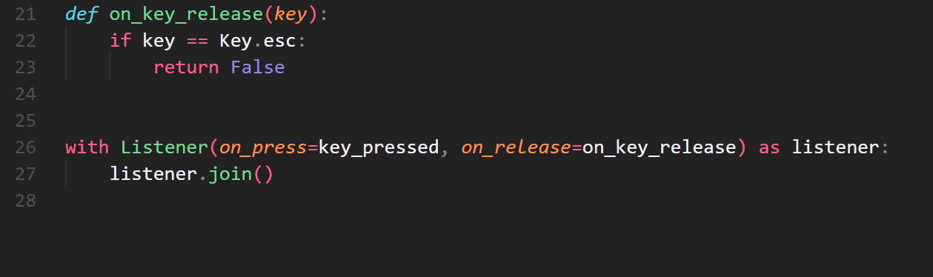

Slide 9
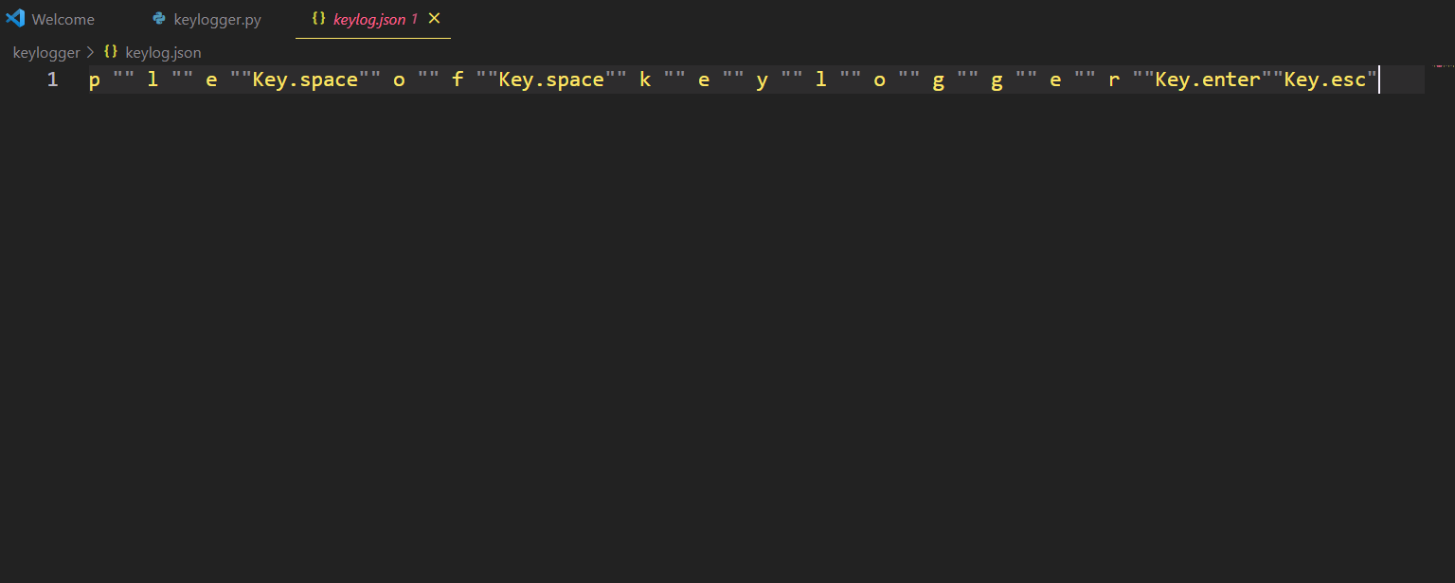
Output (in JASON file):

Slide 10
Conclusion
In conclusion, the Python Keylogger project presents a powerful tool capable of discreetly monitoring and logging keyboard inputs on a computer system. The project's ability to capture keystrokes covertly has potential applications in various domains, such as security enhancement, user behavior analysis, and authorized monitoring scenarios.
While the project offers valuable educational insights into keylogging techniques and Python programming, it also raises significant ethical concerns. It is of utmost importance to emphasize that the keylogger must be deployed responsibly and only for legitimate purposes with explicit consent and proper authorization.
Respecting user privacy and adhering to ethical guidelines should be the top priority when using the Python Keylogger. The project can serve as an educational resource for understanding cybersecurity, data protection, and ethical considerations in the context of monitoring software.

Slide 11
THE END

